Slide 1
EMAIL APPLICATION

Slide 2

Submitted By: Web Development Team-1 Sonu Soni Deepanshi Singhal: Himanshu Reniwal Aman Sharma Shreyansh
Celebal Technologies Private limited
Submitted To:
Celebal Team
Guided By:
Dr.rakhi Mutha

Slide 3
Overview
Objective
Email Basics
What Makes Up An Email
Mail Services
Web Application Development
Future Scope
conclusion

Slide 4
Objective
It allows you to offer promotions, keep people up-to-date with your latest offerings, and simply stay in touch to remind them that you care about their needs.
One of the main objectives of email application is to inform your readers.
Another objective is to attract users .

Slide 5
Email Basics
What is an Email – an electronic message transmitted over a network from one user to another.
Can be as simple as a few lines of text, or include attachments such as pictures or documents.
Email operates across computer networks, primarily the Internet. Today's email systems are based on a store-and-forward model. Email servers accept, forward, deliver, and store messages. Neither the users nor their computers are required to be online simultaneously

Slide 6
What Makes Up An Email
The Header
Who sent the email.
To whom the mail is sent.
When the email was sent.
The email subject.
The size of the email.

Slide 7
What Makes Up An Email
The Body
Contains the message.
May also contain an attachment.
Attachments
If not embedded within the body, attachments are sent along with the email

Slide 8
Mail Services
Three major mail services:
1.Simple Mail Transfer Protocol (SMTP)
2.Post Office Protocol (POP3)
3. Internet Mail Access Protocol (IMAP or IMAP4)

Slide 9
SMTP (Simple Mail Transfer Protocol)
SMTP is a set of communication guidelines that allow software to transmit an electronic mail over the internet is called Simple Mail Transfer Protocol.
It is a program used for sending messages to other computer users based on e-mail addresses.
Mail servers and other message transfer agents use SMTP to send and receive mail messages. User-level email clients typically use SMTP only for sending messages to a mail server for relaying, and typically submit outgoing email to the mail server on port 587 or 465.

Slide 10
POP3 (POST OFFICE PROTOCOL)
POP3 uses TCP port 110 and 995 by default.
Local e-mail clients use the Post Office Protocol version 3 POP3.
Users allow to retrieve e-mails over TCP/IP connection from a remote server.
View the retrieve all the messages
Store them on the user's PC as new messages.
Delete them from the server.
Disconnect.

Slide 11
IMAP4 (INTERNET MESSAGE ACCESS PROTOCOL)
IMAP or IMAP4 uses the TCP port 143 & 993 by default.
IMAP is often used in large networks For example, a college campus mail system.
IMAP (Internet Message Access Protocol) is an email protocol that deals with managing and retrieving email messages from the receiving server.
Since IMAP deals with message retrieval, you will not be able to use the IMAP protocol to send email. Instead, IMAP will be used for receiving messages.

Slide 12
Web Application Development
Technology used
How does EmailJs works ?
Login Web Page
Sign up Web Page
Sending Mail Web Page

Slide 13
TECHNOLOGY USED
REACT
HTML
CSS
JAVASCRIPT
BOOTSTRAP
EMAILJS

Slide 14
How does EMAILJS works?
Emails helps to send emails using client-side technologies only. No server is required – just connect Emails to one of the supported email services, create an email template, and use our JavaScript library to trigger an email.
Email templates can optionally contain dynamic variables in almost any field (e.g. subject, content, TO address, FROM name, etc) which are populated from the JavaScript call. For example, the subject can be "{{ name }}, you have a new message", and using JavaScript the name can be set to “Sonu soni”, for instance.

Slide 15
User Sign up page
It is a process that links user accounts to identify the users and manages the life cycle of the user accounts and access rights.
This module deals with new user registrations, which includes their name ,email , Password details to maintain the account.

Slide 16
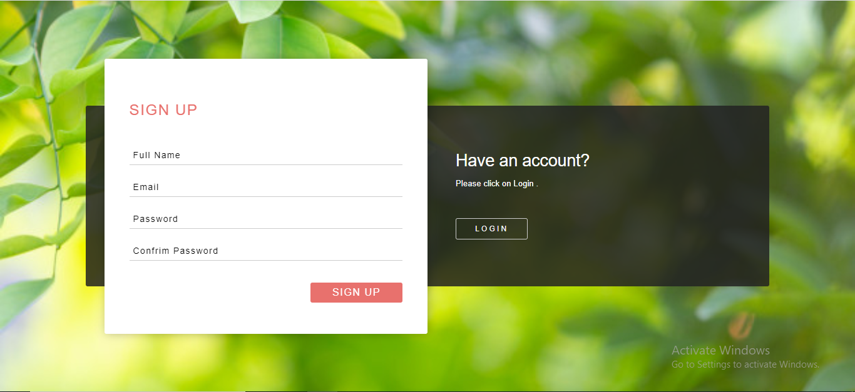

Slide 17
User Login page
This module deals with authentication of users. Verifying whether they are authenticated users or not. If they are authenticated they are
responded with the appropriate web pages otherwise with an error page.
Login is the process by which individual access to a computer system.

Slide 18
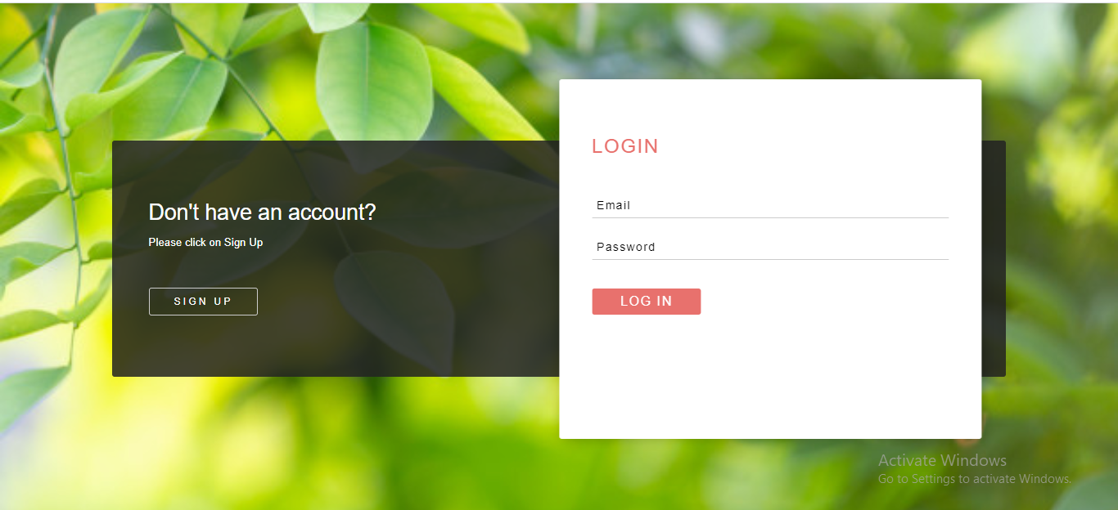

Slide 19
Cilent Server Protocol
The client transmits an email message to the server and it act as an SMTP client.
I used SMTP server with help of emailjs.
This module contains user name, receiver mail ,subject and message details.
After sending mail user can reset input fields and can send again mail to another person .

Slide 20
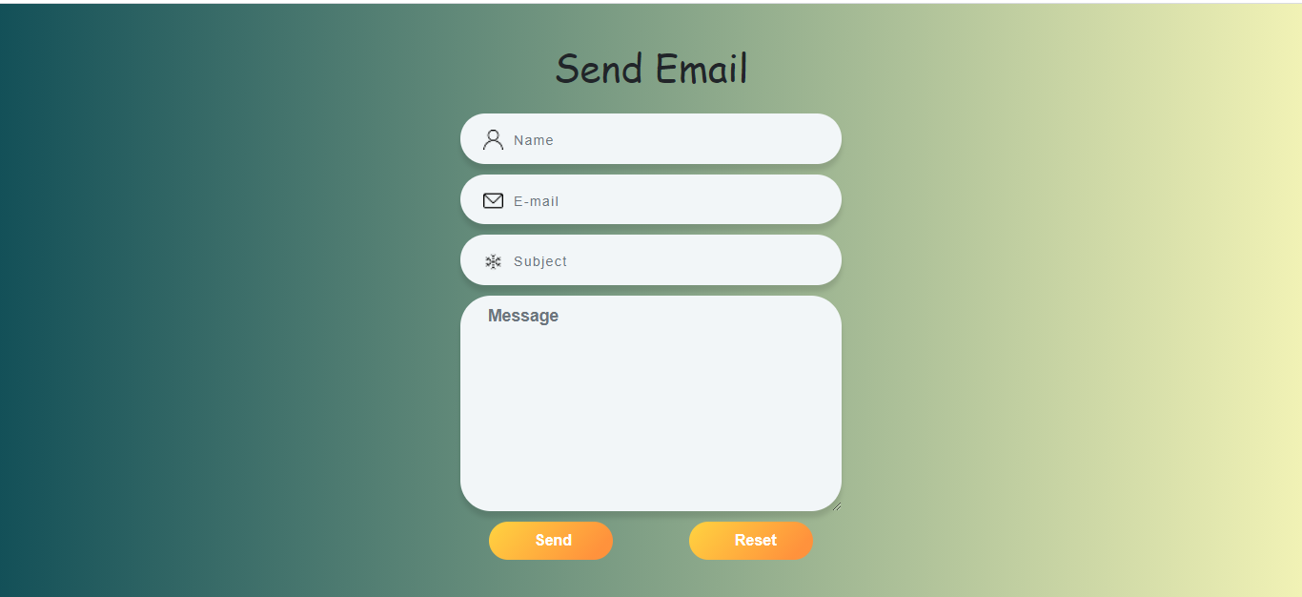

Slide 21
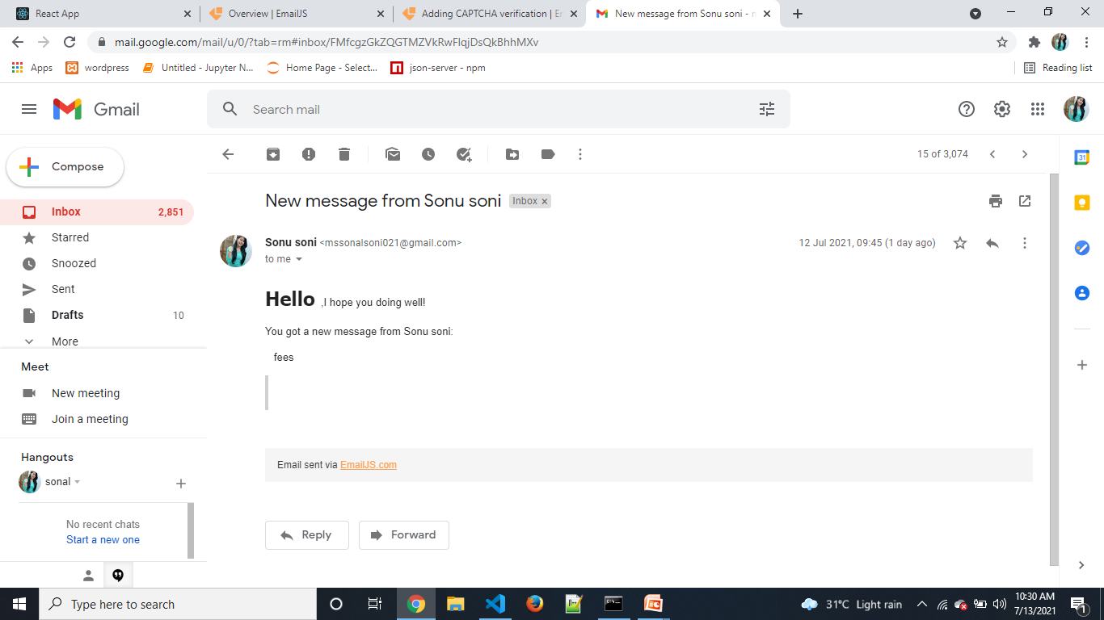

Slide 22
Future Scope
According to the Radicati report, in 2015 the number of business and consumer emails sent and received per day was over 205 billion, and in 2017 it will reach 269 billion, “and it is expected to continue to grow at an average annual rate of 4.4% over the next four years, reaching 319.6 billion by the end of 2021”
Email marketing is very user friendly and cost effective form of marketing .It is used all around the world which allows business to communicate and touch directly with their customers
Email marketing is becoming more and more custom tailored to each individual. From tracking consumer spending habits to their internet usage, marketers are using data to figure out exactly what users need and when they need it.

Slide 23
Conclusion
Here, I have come to the end of the project on the Email Application.
Email App are more secure to any other social sites .It will never going down in the future . It will always go up.
It is most widely using application in the organization .
It ‘s became more using application between an organization and customers.

Slide 24
THANKS!

